Slide 1
Power Platform 101
Seven Sigma Business Solutions

Slide 2
Before we start:
Pick an animal alias for the day
Go to powerapps.com and click Sign In
Sign in with your animal alias (you may need to sign out of your current M365 account)
Go to your app store on your phone and download Power Apps
Sign in with your animal alias

Slide 3

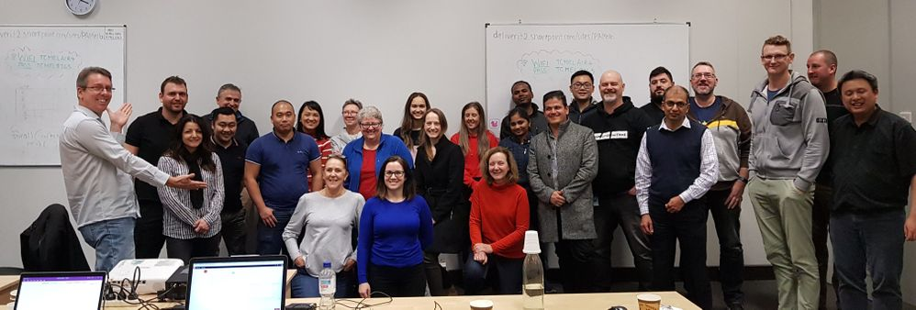
Our Company
Seven Sigma Business Solutions
First in Australia to focus exclusively on Power Platform
Best qualified in Australia for the Power Platform
2 Microsoft Business Applications MVPs
1 of 3 Fast Track Architects in Australia
50% under 30 years old
50% women / nonbinary
Many employees are not "traditional" developers
Proud tradition of mentoring citizen developers & young people
One of our past training events

Slide 4
The Plan
8:30 – 08:40 | Intro
8:40 – 10:15 | Power App from Wizard
10:15 – 10:30 | BREAK
10:30 – 11:00 | Power Automate Workflows pt.1
11:00 – 12:30 | Power App from Scratch pt.1
12:30 – 1:15 | LUNCH BREAK
1:15 – 2:45 | Power App from Scratch pt.2
2:45 – 3:00 | BREAK
3:00 – 3:30 | Power Automate Workflows pt.2
3:30 – 4:00 | Finishing up, questions, etc
Notes:
Perhaps insert an afternoon break

Slide 5








What is the Power Platform?
The Power Platform is a group of low-code Microsoft products (within Microsoft 365) made for citizen developers
Power Apps​
Build apps to capture data in a more efficient, scalable, and user-friendly way than Excel​
Power Automate​
Automate and accelerate multi-step processes and tasks with workflows​
Power BI​
Unify data from multiple sources and display it in interactive dashboards and reports​
​

Slide 6

What kinds of places are actually using the Power Platform?
Woodside
Main Roads
South32
Origin Energy
Vancouver Airport
Rio Tinto
WA Police
Chevron
Local Governments
Universities (eg. ECU)
TAFE
Perth Mint
Wesfarmers
Telstra
And MANY more…

Slide 7
So, what kind of scenario will we be building an app for today?

Slide 8


Slide 9
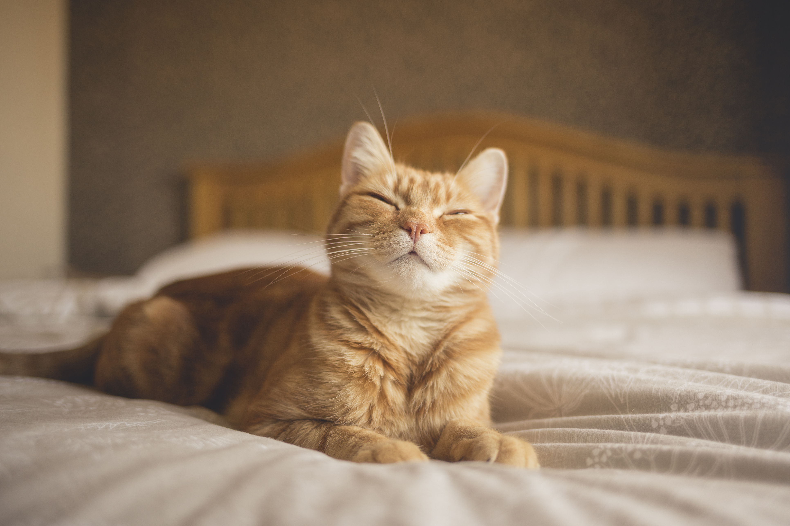
Build a pet adoption app in just a few clicks

Slide 10
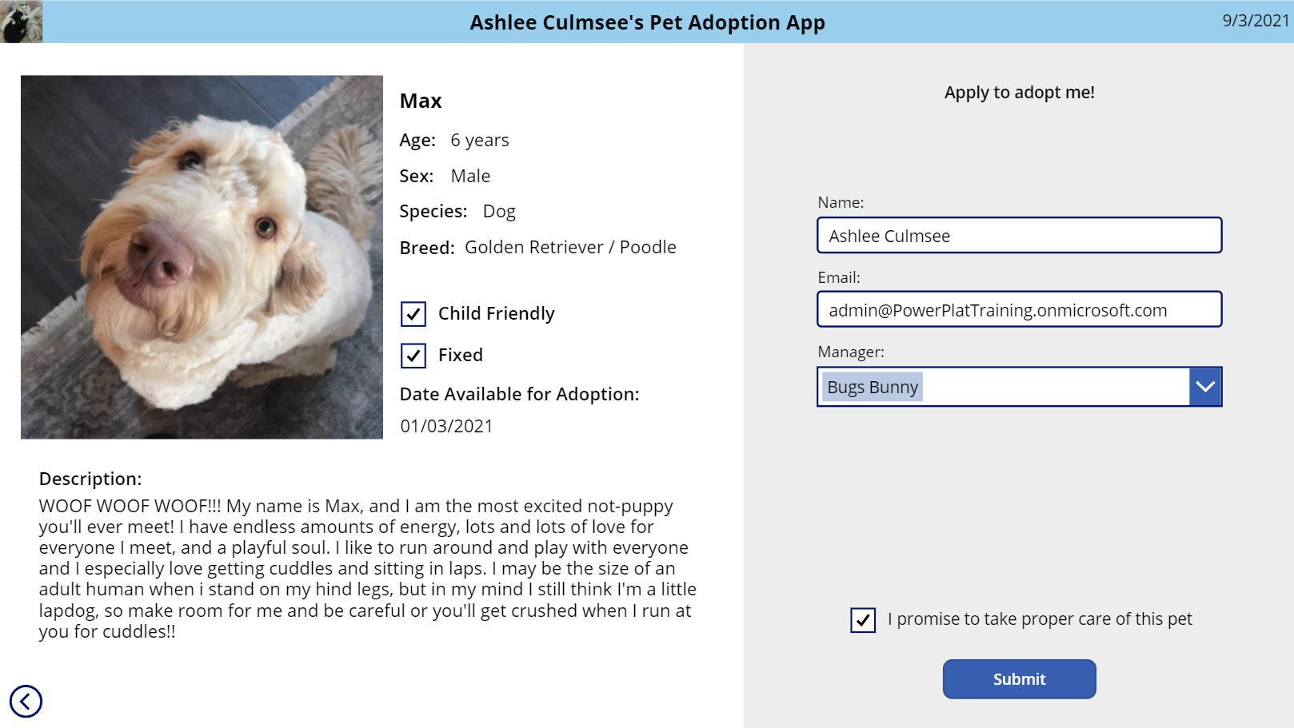
Let’s make a full pet adoption app from scratch

